Slide 1
MUHAMMAD MUSTAFA MANGA
FAST-NUCES
17K-3795
SECTION-E2
SUBMITTED TO:
SIR ABDUL WAHEED HARIS

Slide 2
PERSONALITY
“SHAHMEER AAMIR”
OBJECTIVE:
To create awareness among students about the hidden talent of Pakistan.
AUDIENCE:
Intellectual Classmates & Teacher.
CONTEXT:
Classroom, Informational.
TIME: 5-7 mins (3 min for Q/A session)

Slide 3
INTRODUCTION
“My primary role has been to discover exploits in products and services we use in our daily life.” – (Shahmeer Aamir)
Exceptional Hacker.
Pakistan’s Hidden Talent.
Most Certification in the field of Cyber Security.
Cyber Security Researcher

Slide 4
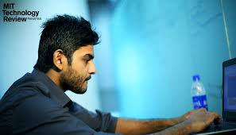
EARLY LIFE & EDUCATION
Born in Multan, Pakistan.
Primary Education from
Rangers Public School.
Intermediate from Govt.
Degree College Karachi.
Scholarship from Hamdard University. (Not Availed)
B.E (EE) from UIT.

Slide 5
Early Life & Eductaion
Fond of Computers.
Started hacking from the age of 18.
Finding bugs in components of computer & solving them.
Attended Seminars on Cyber Security.

Slide 6
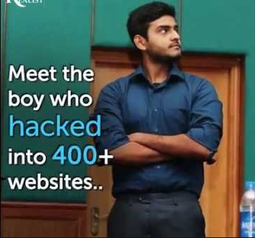
ACHIEVEMENTS
World’s 3rd most top ranked bug hunter.
11th most top-rated hacker in the world.
Found bugs in 400+ Global Organization in just two years.

Slide 7
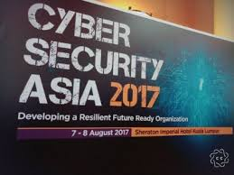
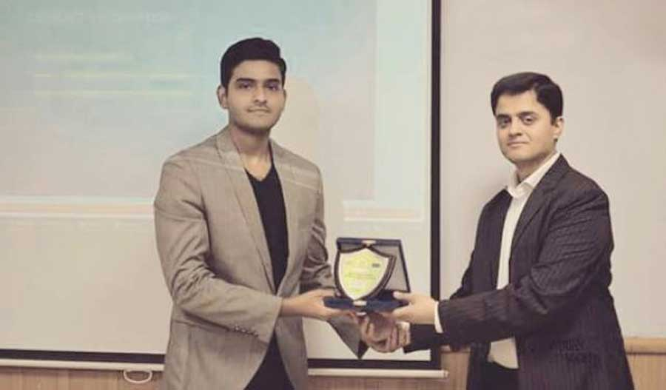
ACHIEVEMENTS
Attended DefCON conference & HackerOne at an early age of 21.
Founder and CEO of Pakistan’s Cyber Security startup “VEILUX”.

Slide 8
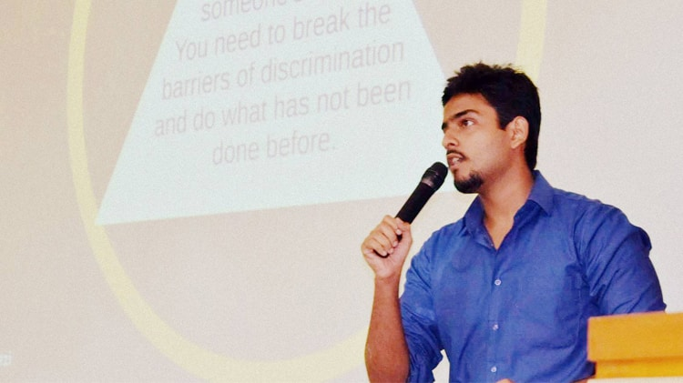
CONTRIBUTIONS
5 methods Ladies can use to protect their online information from being misused.
Blockchain, The solution for Corruption in Pakistan.

Slide 9
Conclusion
Aim of presentation.
How I was inspired by this personality?
Conclusive message.
“If we study only for the sake of job then we become servants not gentleman.”

Slide 10

THANKYOU !

